Slide 1
Airline Ticket Reservation System(ATRS)
Submitted By:
Group No: 85
2196-Rahul
2199-Sayyam

Slide 2
The Airline Reservation System helps the customers to search the availability and prices of various airline tickets, along with the different packages available with the reservations.
It contains airline schedules, fare tariffs, passenger reservations and ticket records.
• An airline’s inventory contains all flights with their available seats

Slide 3
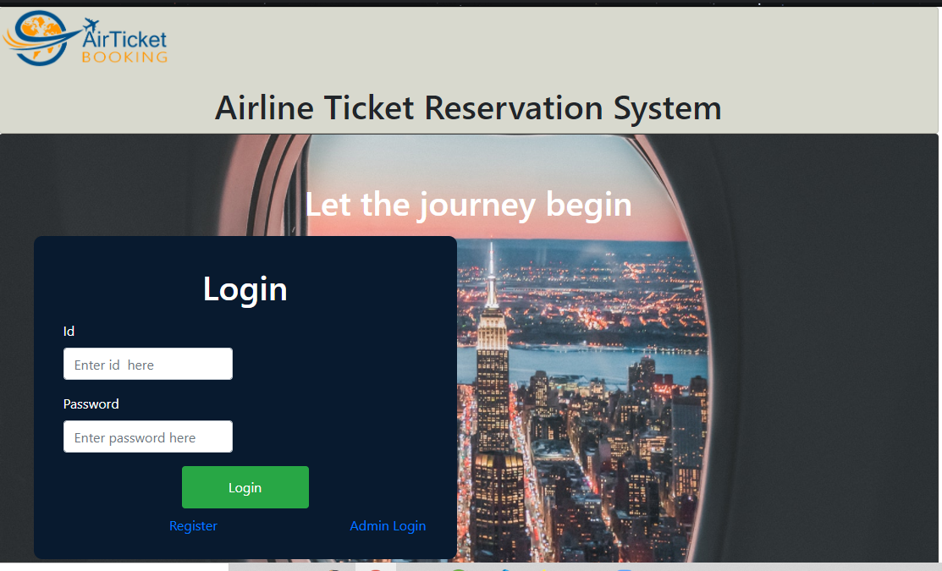
Login Page

Slide 4
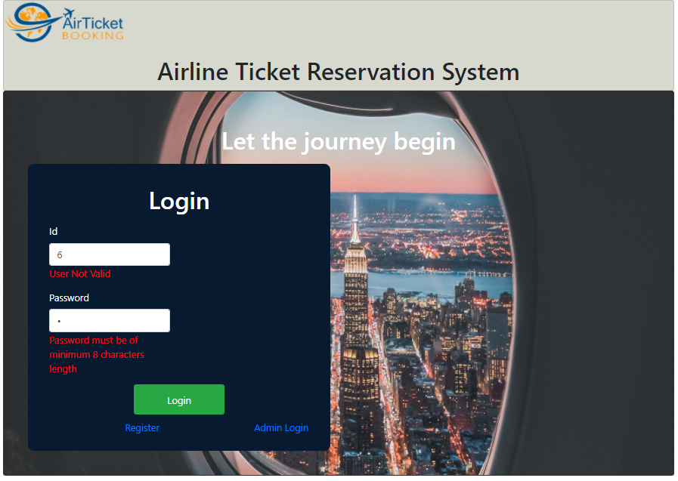
Validation Rules:

Slide 5
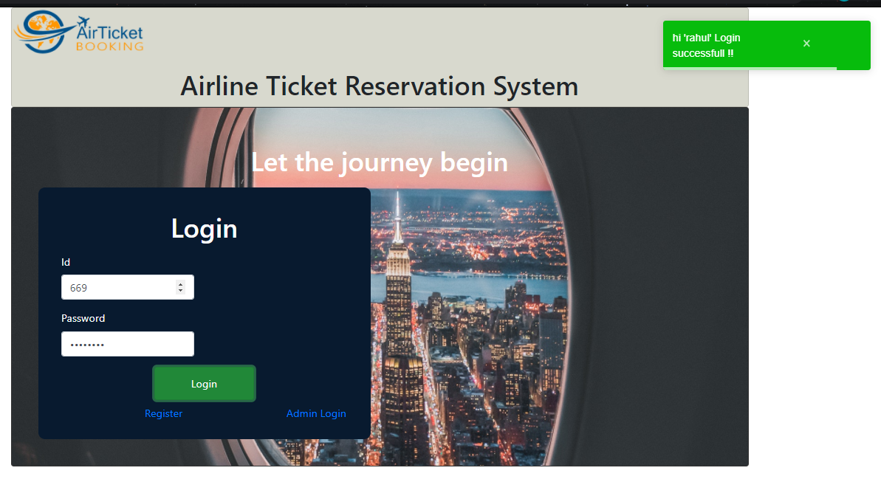
Successful Logged in Message

Slide 6
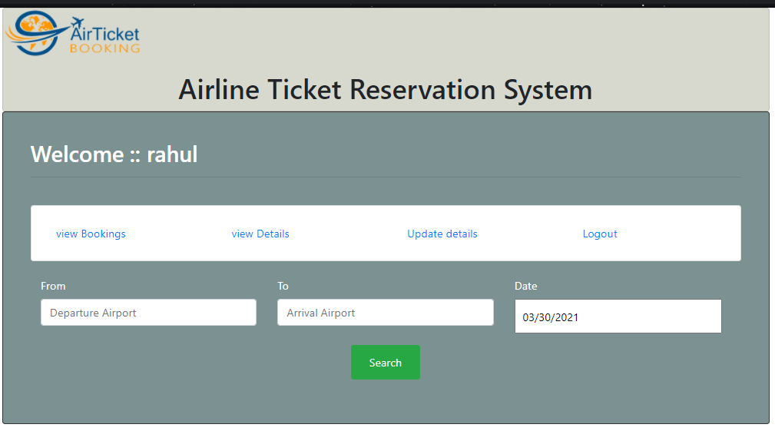
User Functionality

Slide 7
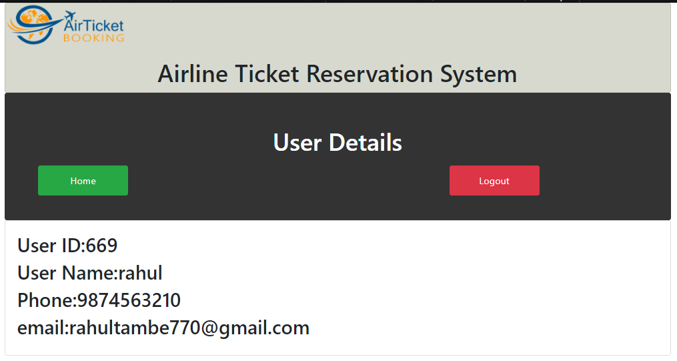
User Details

Slide 8
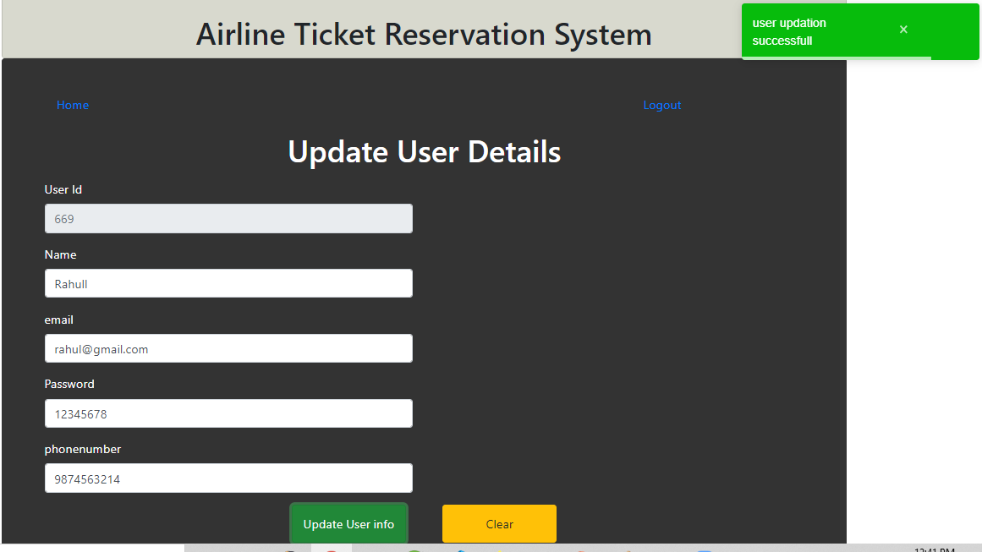
User Details Updations

Slide 9
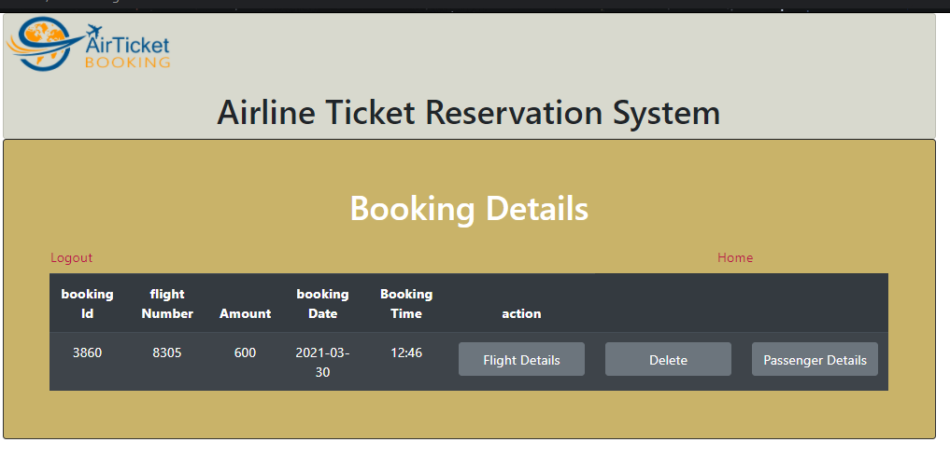
Booked Flight Details

Slide 10
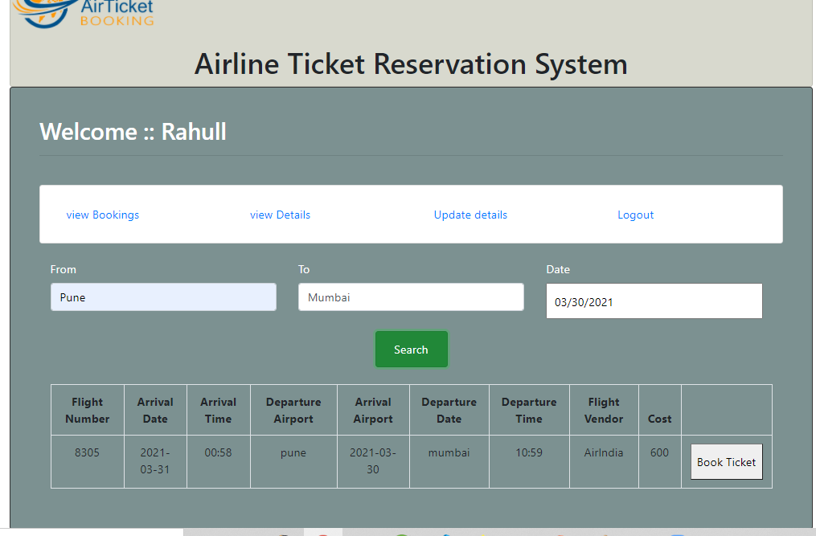
Flight Details Search

Slide 11
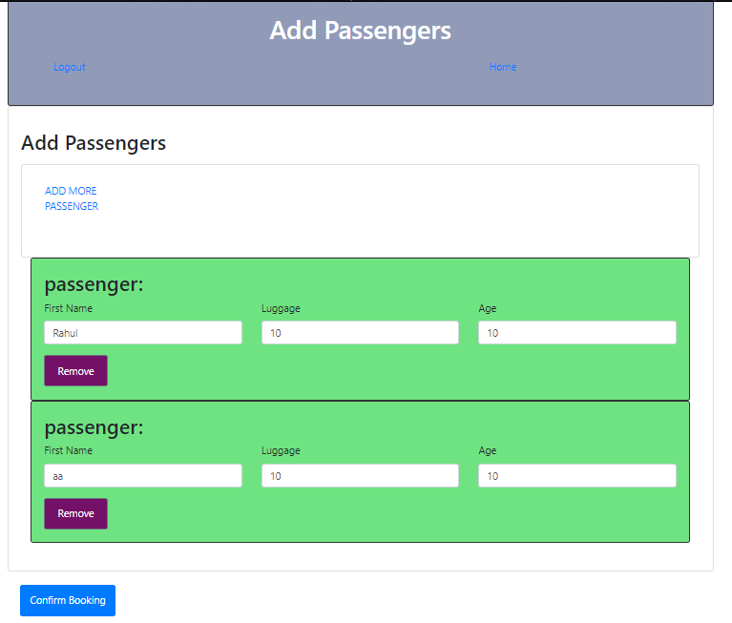
Passengers Add

Slide 12
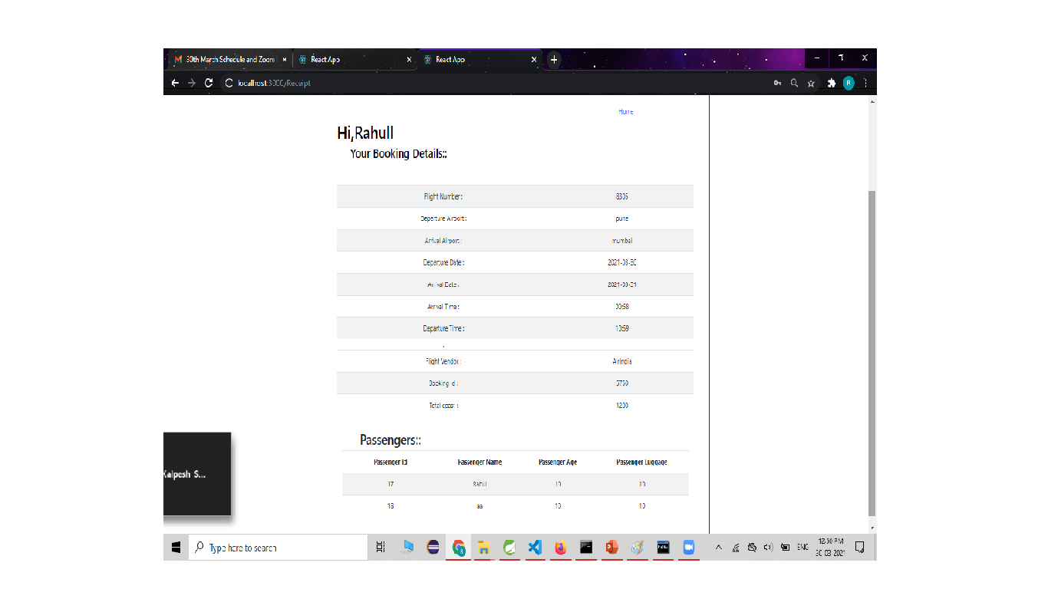
Receipt:

Slide 13
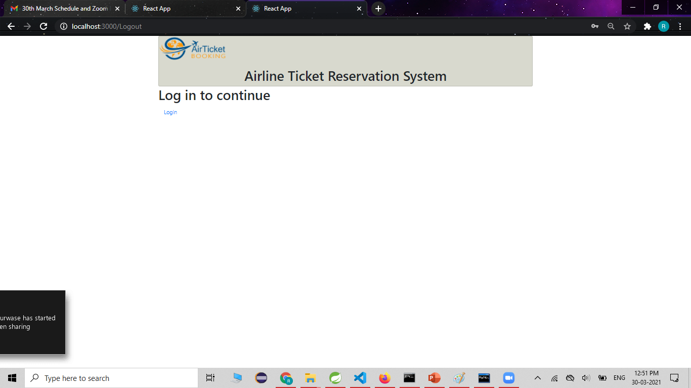
Logout:

Slide 14
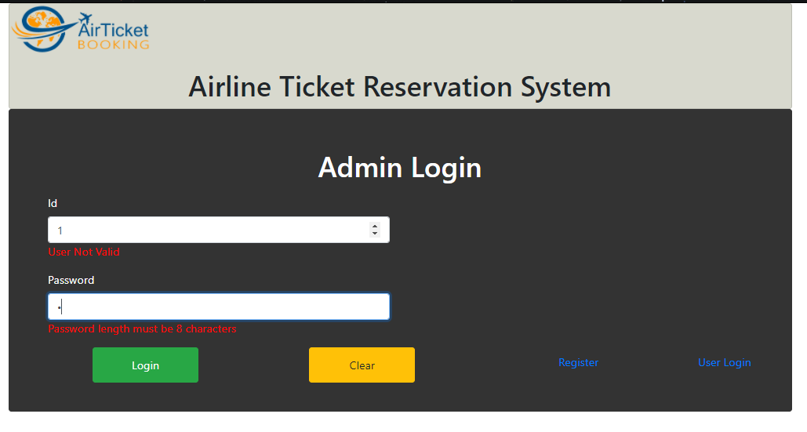
User Registration

Slide 15
Admin Login

Slide 16
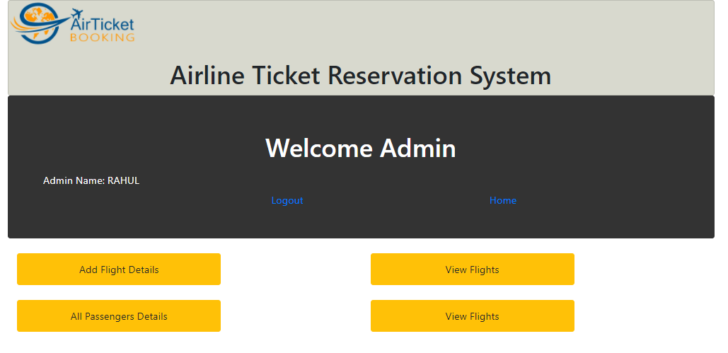

Slide 17
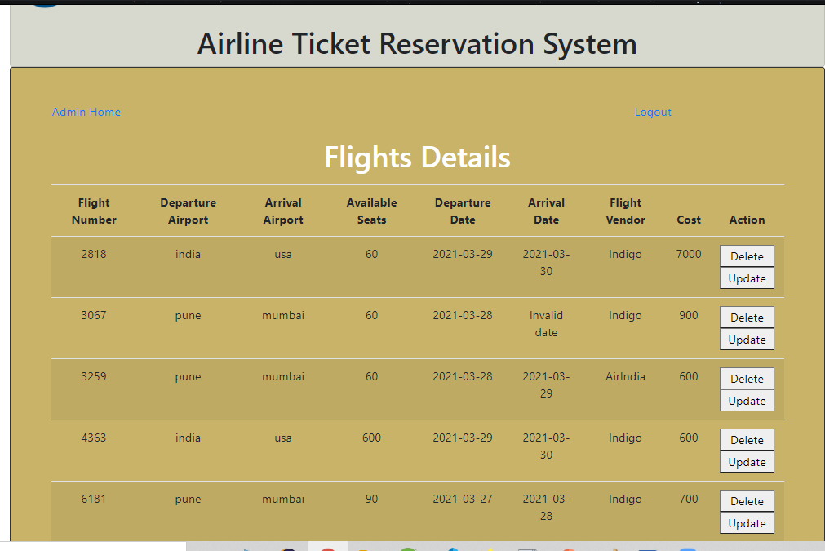
Admin flight details

Slide 18
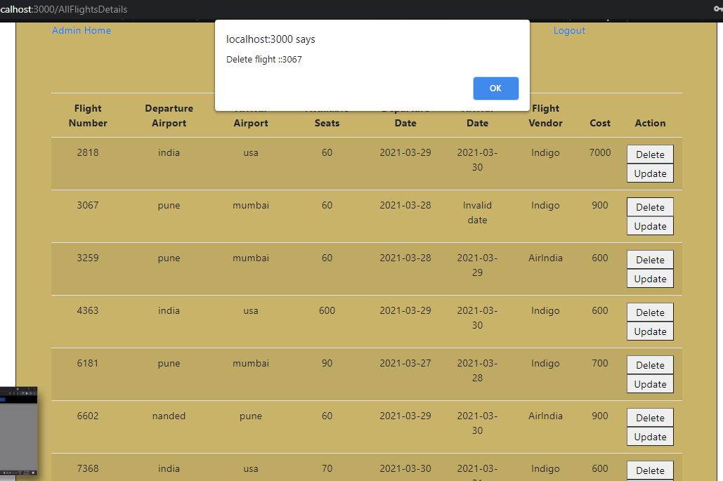
Admin can delete flight

Slide 19
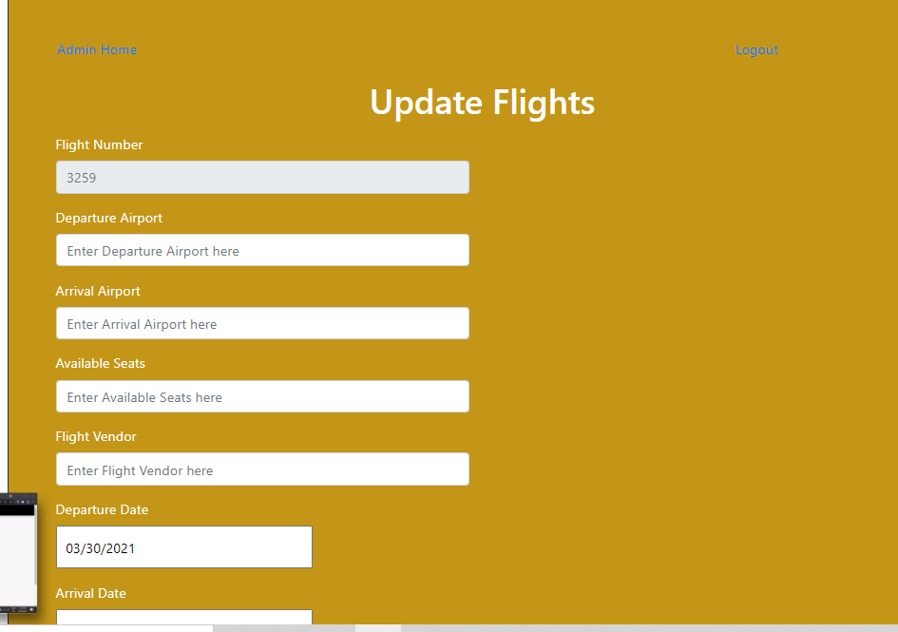
Admin can update flight details

Slide 20
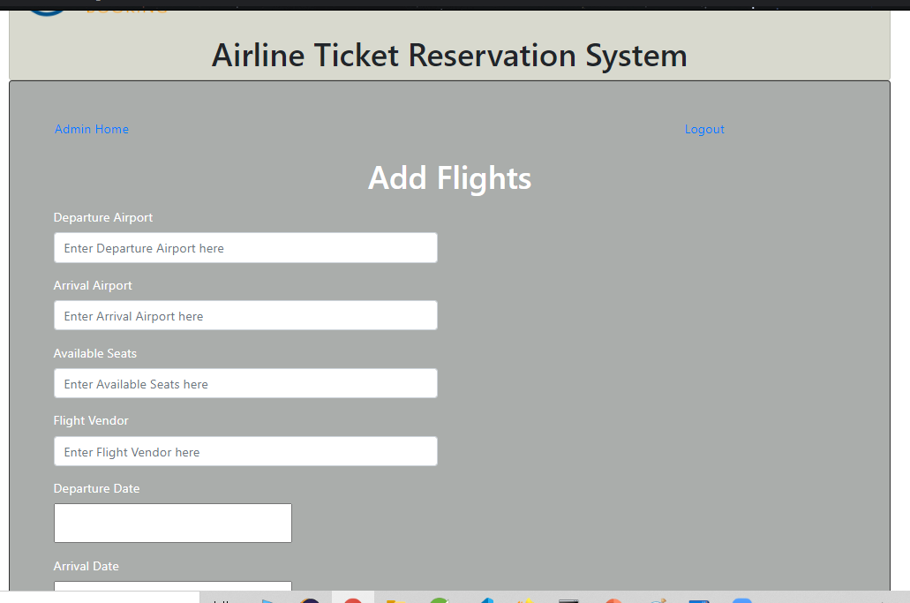
Flight add

Slide 21
Reference Documents
1.Naveed Ali, Richard Lai, A method of software requirements specification and validation for global software development, June 2017, Volume 22, Issue 2, pp 191–214(​https://link.springer.com/article/10.1007/s00766-015-0240-4​)
2. Luke Paireepinart, David Keyes, Jingtao Liu, Frank Medjo and Seth Orell, Software Requirements Specification for Airline Flight Booking System, February 2009(​http://www.academia.edu/23567842/Software_Requirements_Specification_for_Airline_Flight_Booking_System_Software_Requirements_Specification_for_Airline_flight_booking_system​)
3. ​www.wikipedia.com

Slide 22
Thank you…

